Slide 1
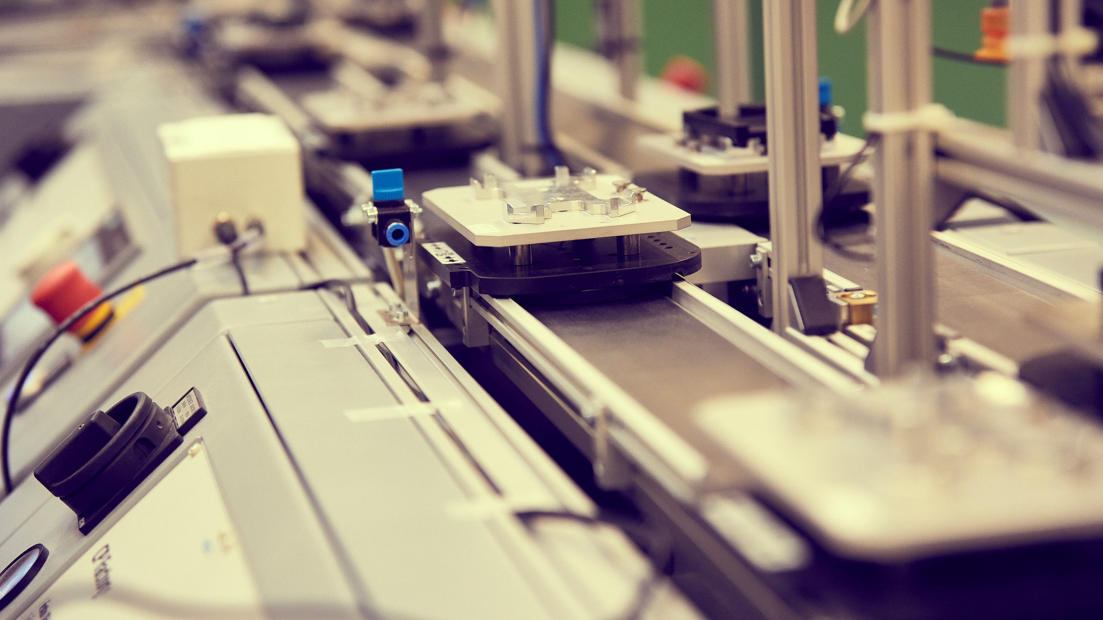
DEPARTMENT OF
MATERIALS & PRODUCTION
AALBORG UNIVERSITY
BY KJELD PEDERSEN

Slide 2
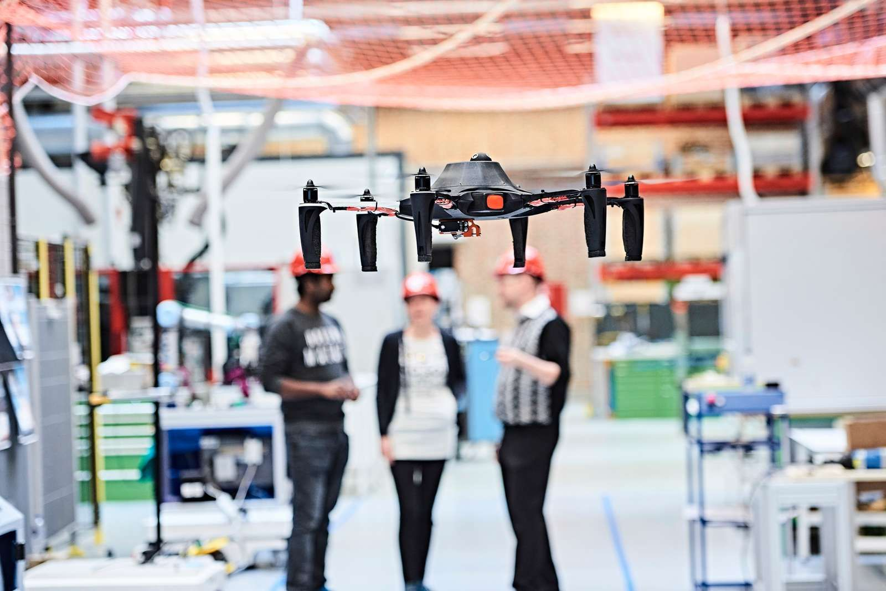
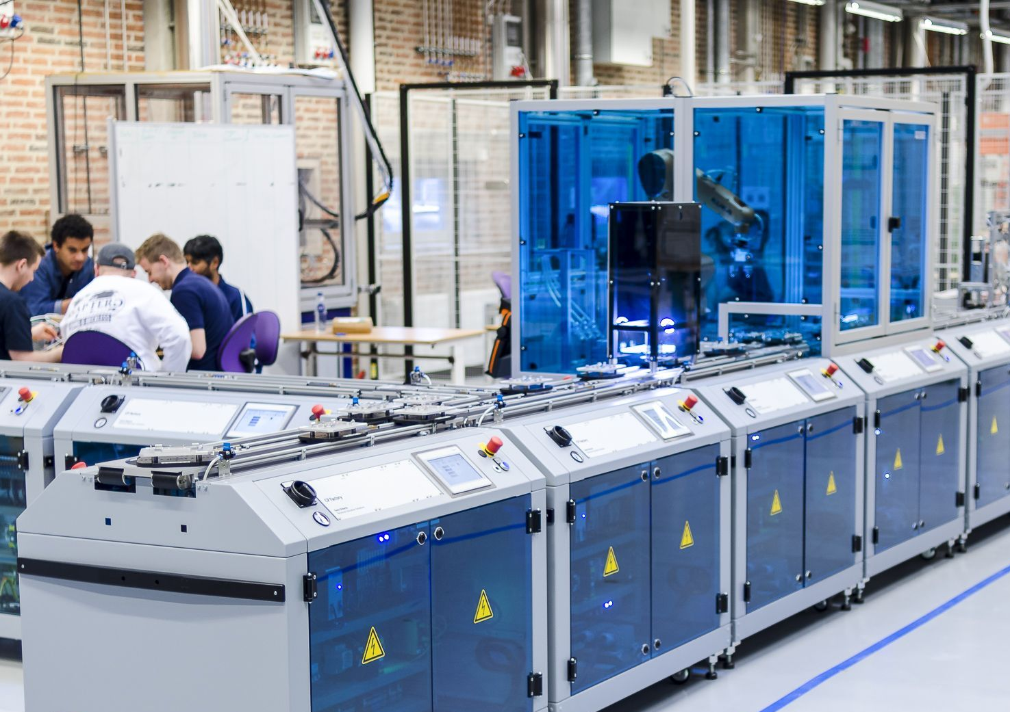
DEPARTMENT OF MATERIALS & PRODUCTION
The Department of Materials and Production conducts research in the intersection between new advanced materials, mechanical constructions, digital production technologies and industrial management.
We have a strong commitment to provide technologies and solutions to the major societal challenges. Our research involves strong collaboration with national and international partners as a key driver for innovation, productivity and growth in Europe.
KEYWORDS
Materials Science
Physics
Mechanical Engineering
Production Systems and Technology
Industrial Production and Management

Slide 3


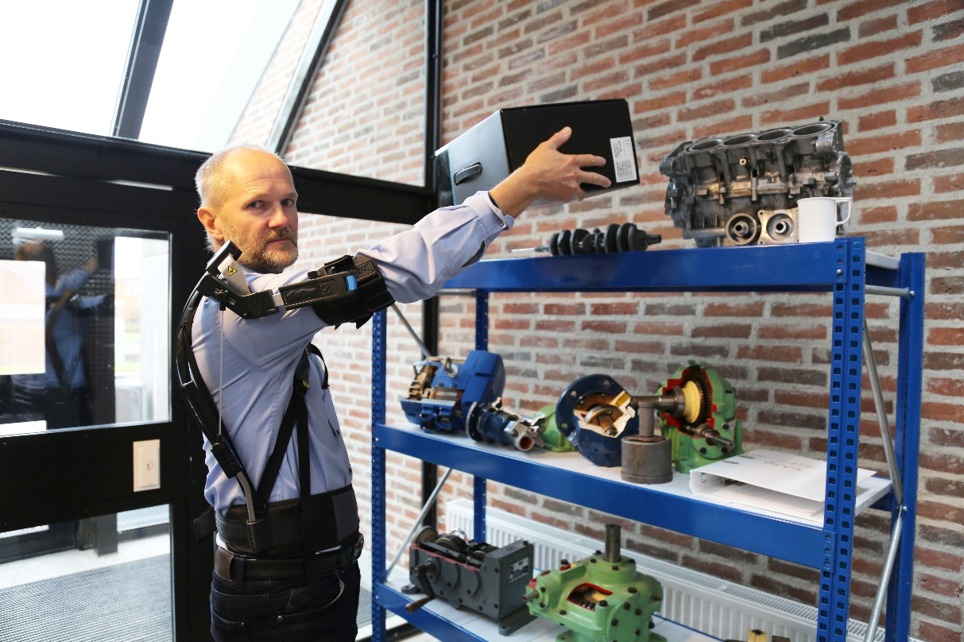
RESEARCH PROGRAMS
The Department of Materials & Production has successfully launched 3 interdisciplinary research programs within the fields of dynamics, biomechanics, robotics, materials and operational systems.
Our research initiatives bring some of our best researchers across disciplines together and strengthen the departments lead position in Europe, aiming to develop new techniques, methods and tools.
PROGRAMS
AAU Center of Exoskeletons
AAU Recycling of Plastics
AAU Healthcare Operations

Slide 4
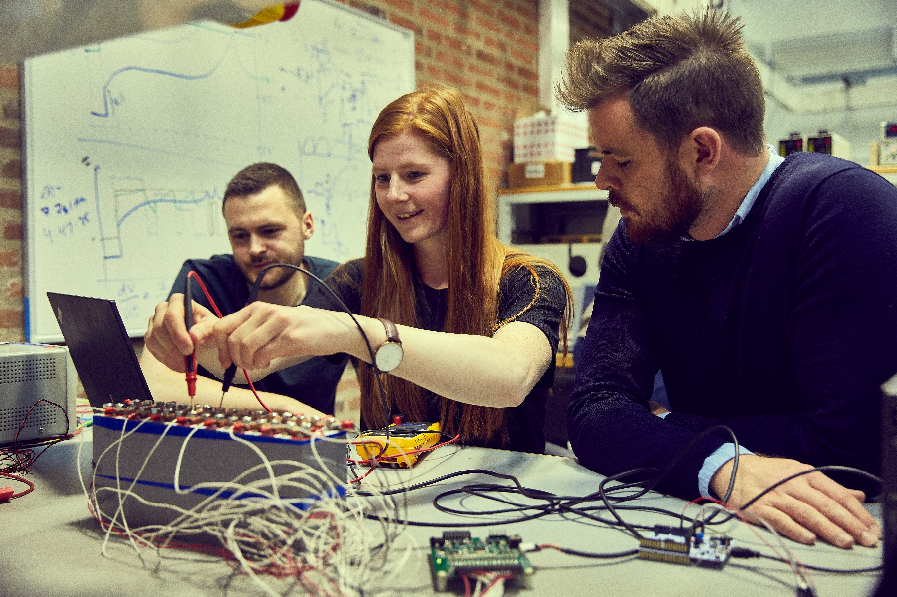
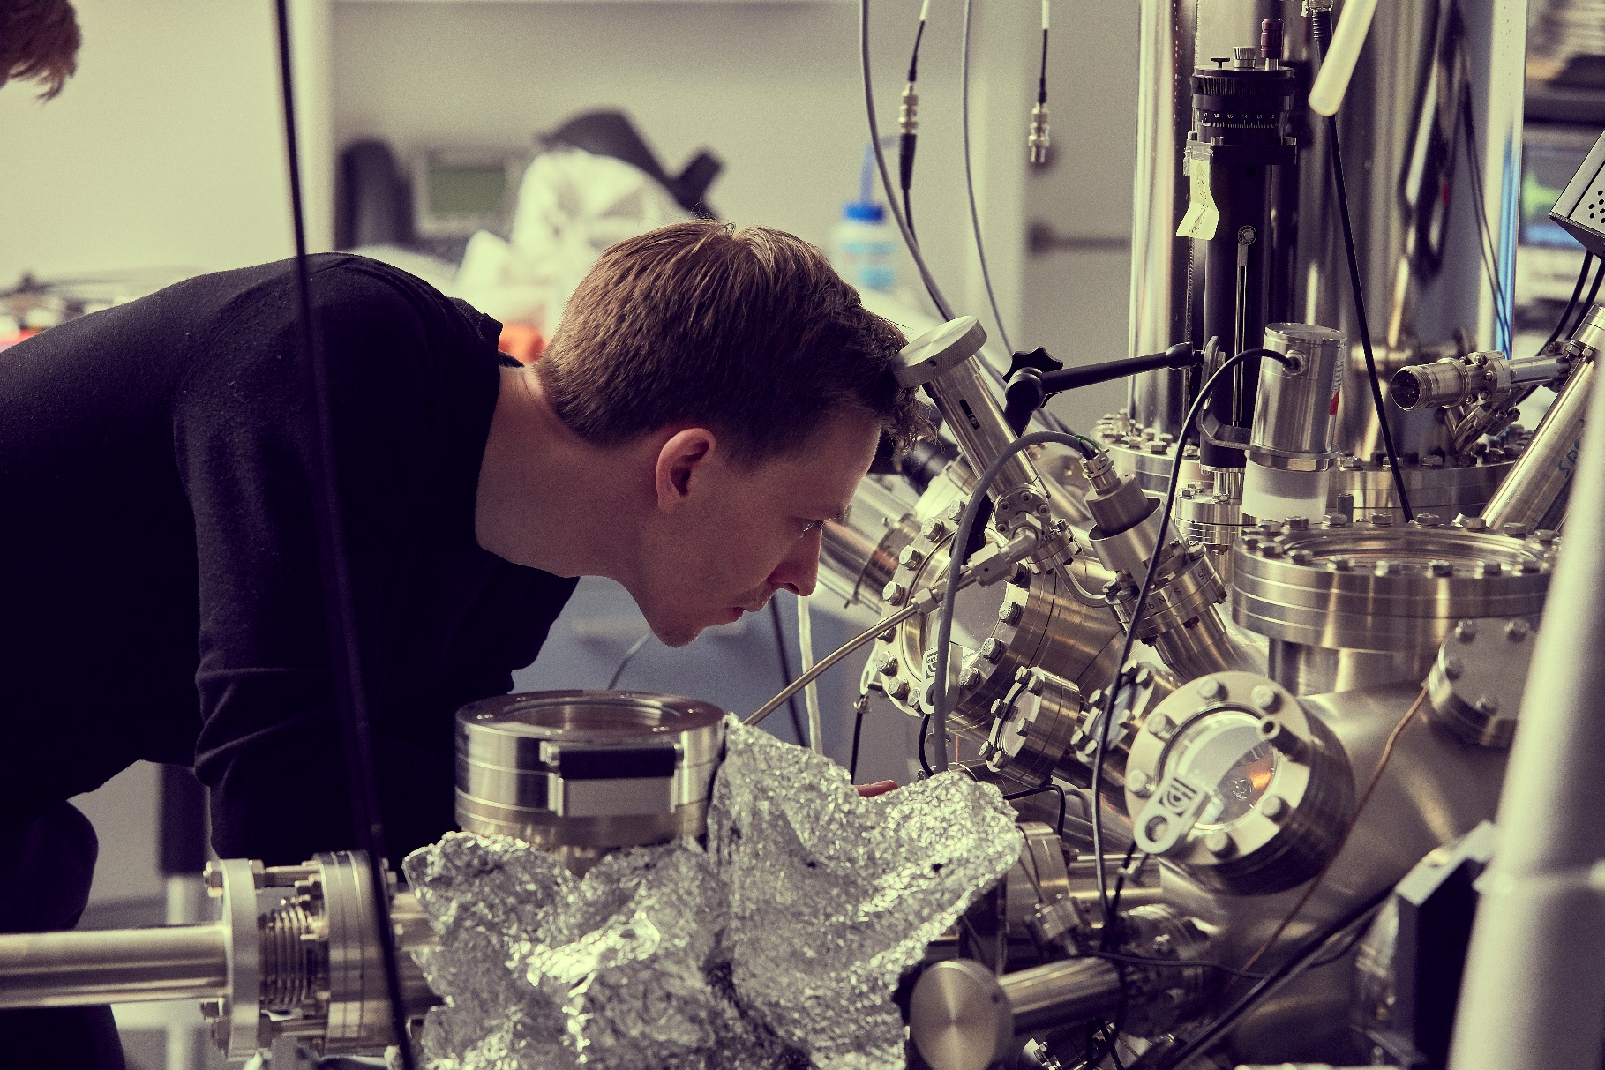
RESEARCH FACILITIES
The Department of Materials & Production has state-of-the-art research facilities and equipment to conduct experimental research tests within the fields of material science, mechanical and production engineering.
Our highly skilled staff is updated on the use of new technologies, industry demands and global trends and working to train, support assist researchers at all stages of their career.
LOCATIONS
Fibigerstraede
Skjernvej
Badehusvej (Student lab)

Slide 5

REMARKABLE RESULTS, GRANTS AND AWARDS
The Department of Materials & Production is one of the founding members of MADE, Manufacturing Academy of Denmark, www.made.dk. In total the department has received more than 43 million DKK in external funding to research projects related to MADE activities.
In 2019 The Department of Materials and Production received DKK 18.2 million from North Denmark Growth Forum to the project Innovation Factory North.

Slide 6

KEY FIGURES
160 staff
  App. 65 faculty members
  App. 27 Post Doc/RA
  App. 20 PhDs
  More than 11 guest researchers
  App. 44 TAP
App. 1025 students
Total turnover DKK 158,4 million
External turnover DKK 48,4 million
Internal turnover DKK 110,0 million
Number of external projects >163 on-going
New External Portfolio DKK 29,2 million
App. 4.440 m² LAB facilities

Slide 7
ORGANIZATION
Materials and Production
Kjeld Pedersen
Department Head
Johnny Jacobsen
Head of Laboratories
Jette Marie Christensen
Head of Secretariat
Physics and Mechanics
Section head
Jens Henrik Andreasen
Production
Section head
Astrid Heidemann Lassen
Administration
Materials Science and Engineering
Operations Research
Economy and
Projects
Solid and Computational Mechanics
Robotics and Automation
Department and Communication
Mass Customization
Biomechanics
CELOG
Studies
Physics
CIP

Slide 8
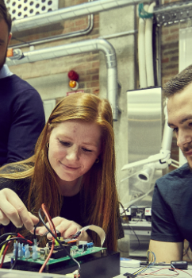
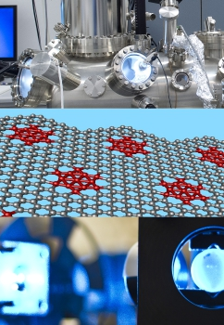
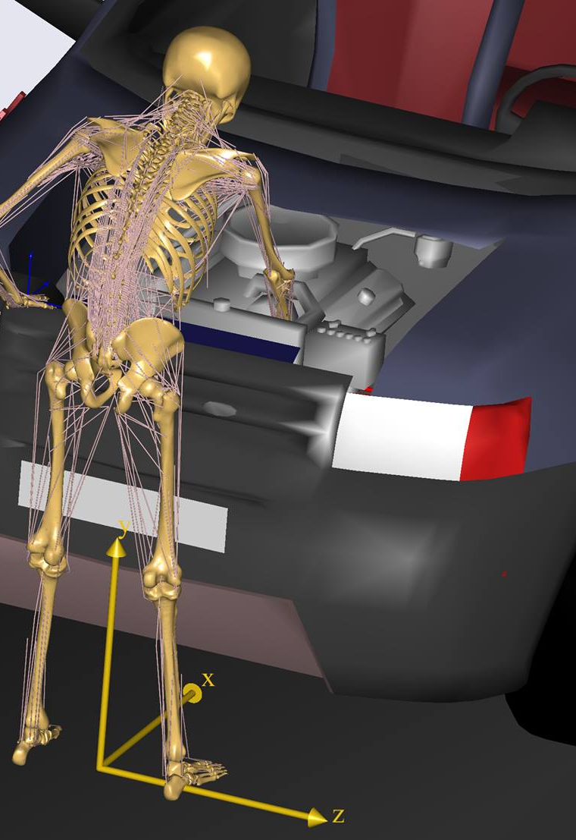
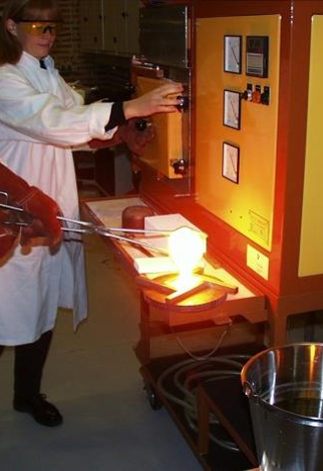
SECTION FOR PHYICS AND MECHANICS
KEY COMPETENCES:
Structural Optimization
Vibroacoustics
Exoskeletons and robots
Composite materials
Material science
Nanophysics
Biophysics
Biomechanical modelling

Slide 9
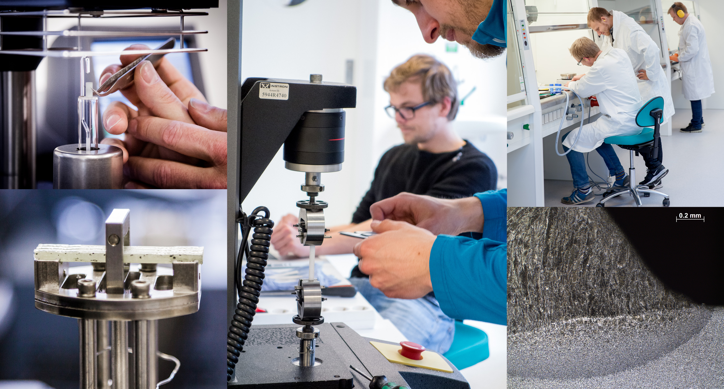
RESEARCH GROUPS
DEPARTMENT OF MATERIALS AND PRODUCTION
SECTION FOR PHYSICS AND MECHANICS

Slide 10
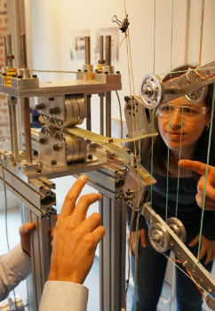
Solid and Computational Mechanics
RESEARCH FOCUS
Structural optimization
Vibro-acoustics, noise, and acoustic metamaterials
Dynamics, robot design
Exoskeleton design and analysis
Analysis and design of composite structures
Mechanical analysis and design
Fracture and fatigue of composites
FEM based design and analysis
Modeling of vehicle dynamics
Ballistic impact

Slide 11
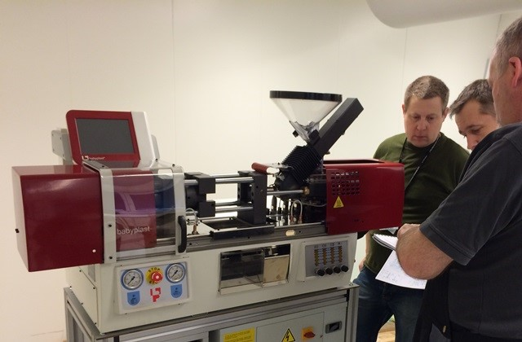
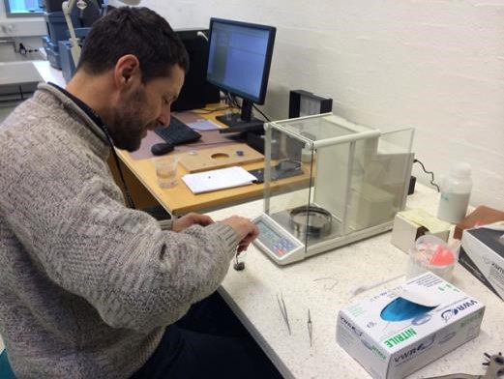
Materials Science and Engineering
RESEARCH FOCUS
Nanostructured materials
Nanoparticle and nanotube filled polymers
Functional and structural properties
Closed loop between processing and fabrication
Polymers, polymer based composites
Metal alloys, ceramics and microcellular materials
Strength and fatigue of welded materials
Electrospinning of polymer fibers
Drug delivery systems
Electrochemistry and corrosion

Slide 12
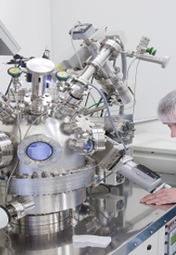
PHYSICS
RESEARCH FOCUS
Theoretical Nano Physics
Terahertz radiation
Thermo Photovoltaics
Materials science in power electronics packaging
Cluster Beams for Materials Modification on the Nanoscale
Nanoscale Materials Science
Optics and Spectroscopy
Theoretical analysis of EM fields in micro- and nanostructures

Slide 13
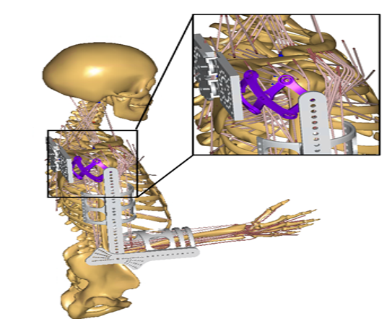
Biomechanics
RESEARCH FOCUS
Biomechanics
Musculoskeletal simulation
Multibody dynamics
Tissue simulation
Exoskeleton and body interaction
Prevention of knee osteoarthritis
Personalized treatments
Determining muscle and bone loading using Motion Capture
Sports technology

Slide 14
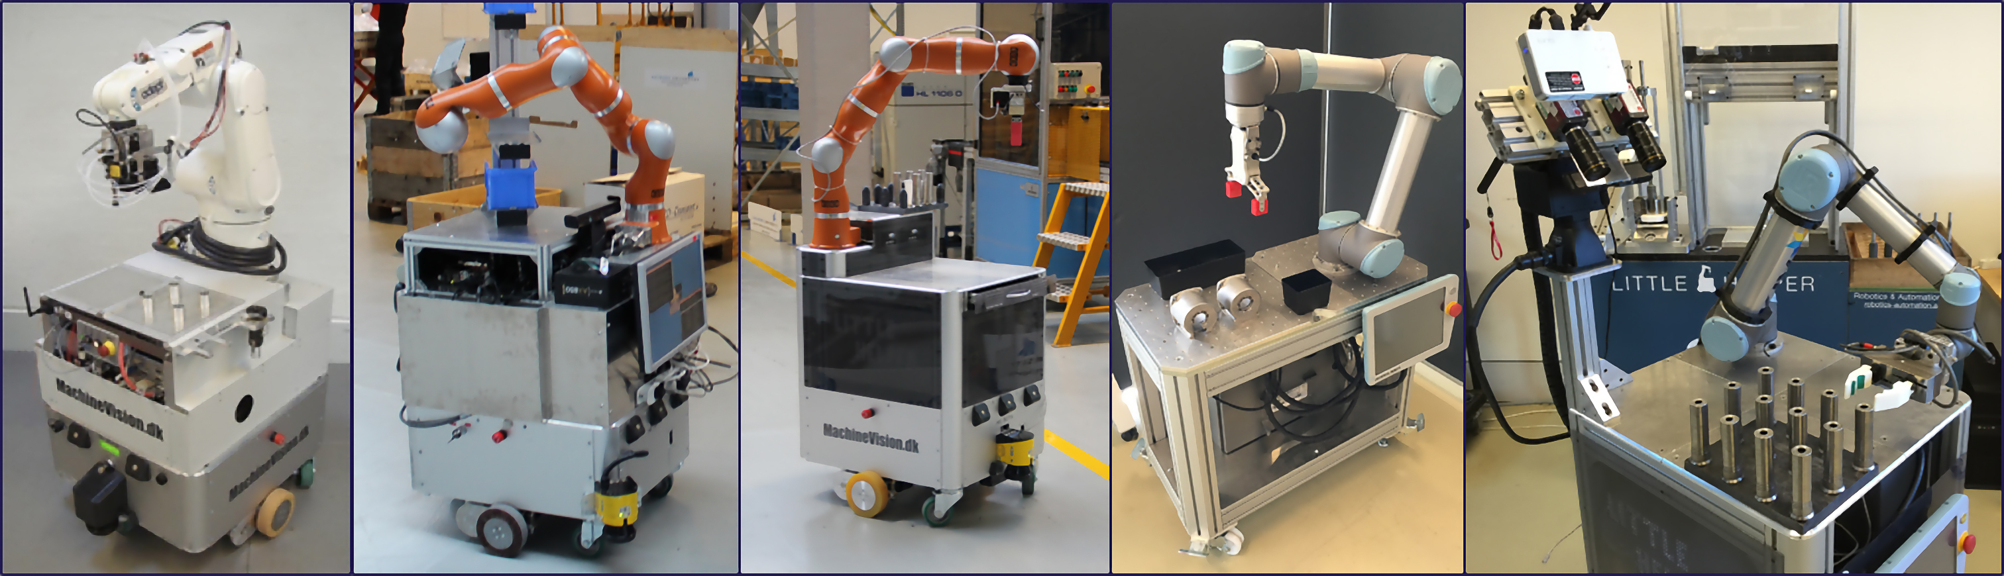
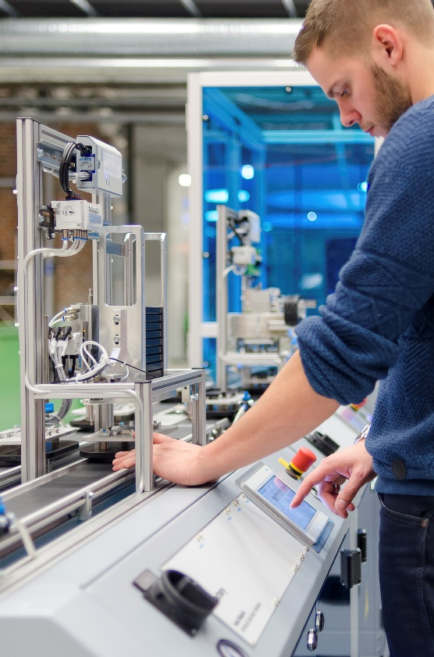
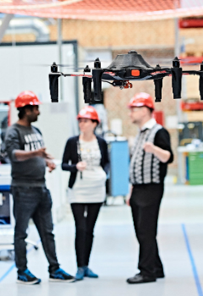
SECTION OF PRODUCTION
KEY COMPETENCES:
Smart Production composed of:
Intelligent Supply Chain
  Reverse supply chain/ Sustainable supply chain development
  Logistic systems
  Planning and control
Digital Manufacturing
  Digital integration of manufacturing technologies
  AI and autonomous systems
  Advanced Robotics
Digital Workforce
  Empowered workforce from shop floor to the board room
  Man-machine interaction

Slide 15
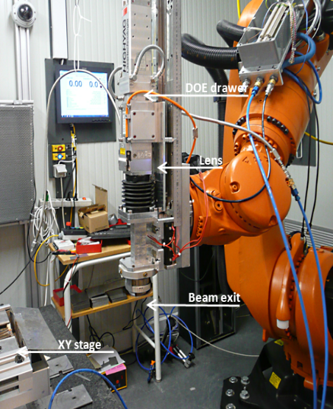
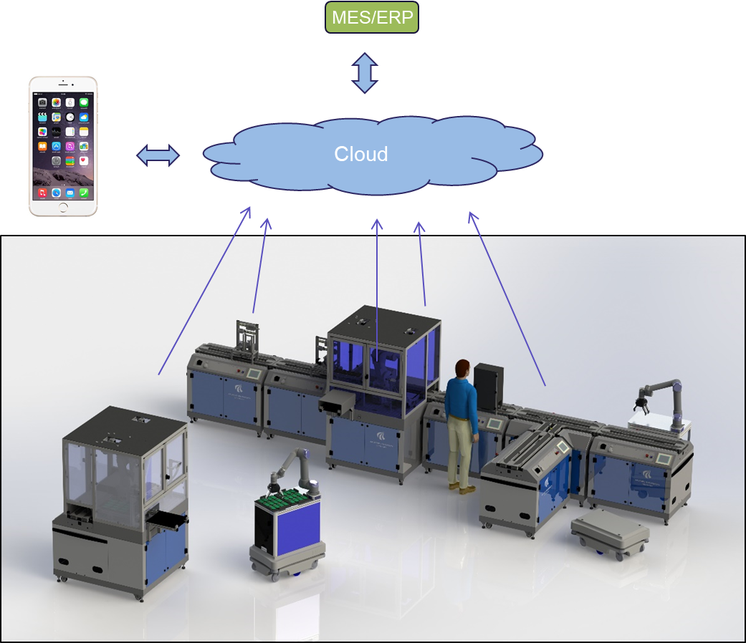
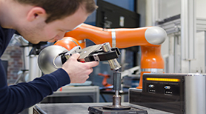
Robots & Automation
RESEARCH TOPIC
Adaptive and self-learning manufacturing systems and robots
RESEARCH QUESTION
How do we design automatic manufacturing systems:
  which are flexible as well as efficient
  which can be scaled in terms of capacity
  better and more efficiently than today. Eg: faster, cheaper (reduced cost), smarter (innovate)
RESEARCH FOCUS:
Laser processing
  includes: remote laser cutting & welding, Hybrid laser welding, Laser forming, Multi axis robot control,
AI for industrial robots
  includes AI, Collaborative robots, Human-robot interactions, mobile manipulators, Computer Vision
Smart factories
  includes: Reconfigurable manufacturing systems, Advanced robotics, Digital manufacturing, Industry 4.0, industry transfer

Slide 16
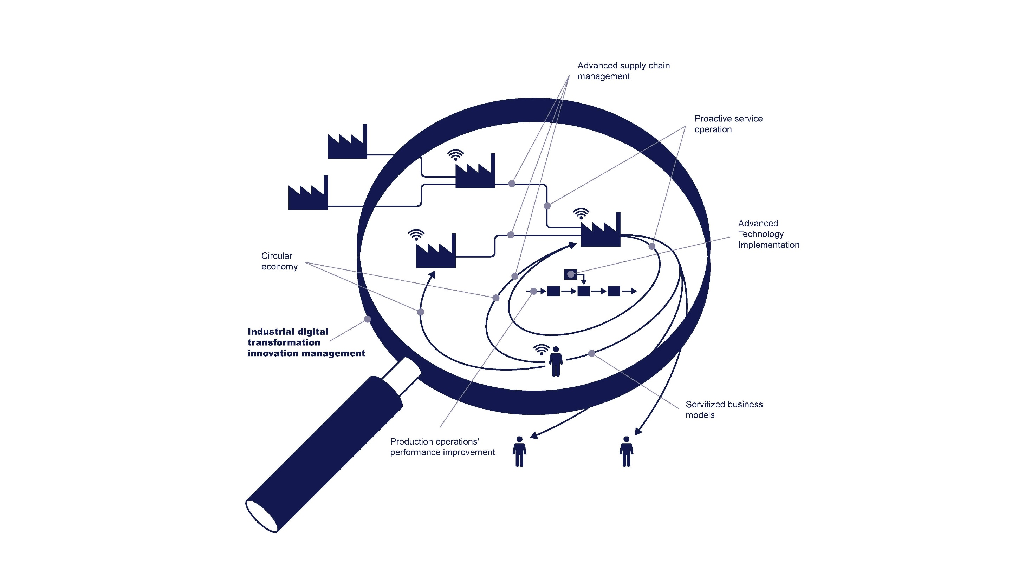
Center for Industrial Production
RESEARCH FOCUS
Operations & Supply Chain Strategy and Management
Innovation Management with a particular focus on adoption of advanced systems technology.
Manufacturing Networks and Ecosystems – flows of products, technologies and knowledge in complex networks.
APPLICATION DOMAINS
Industrial manufacturing and supply chains
Product service systems
Healthcare

Slide 17
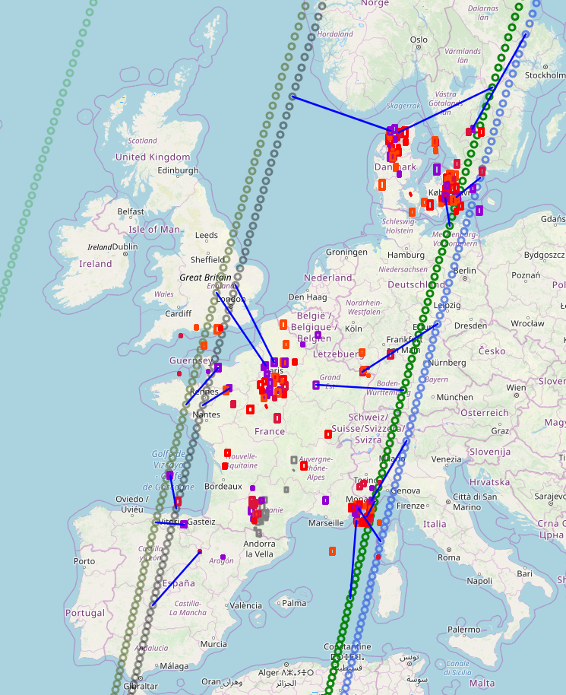
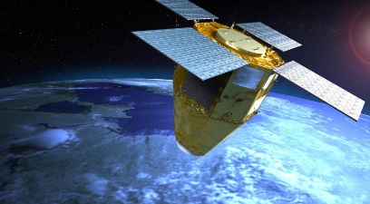
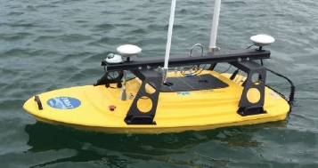
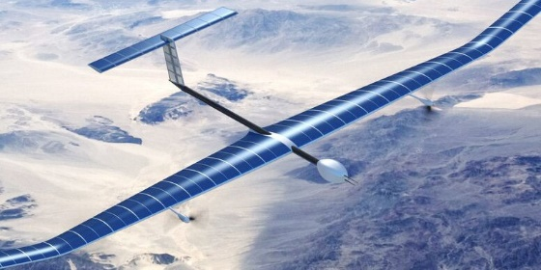
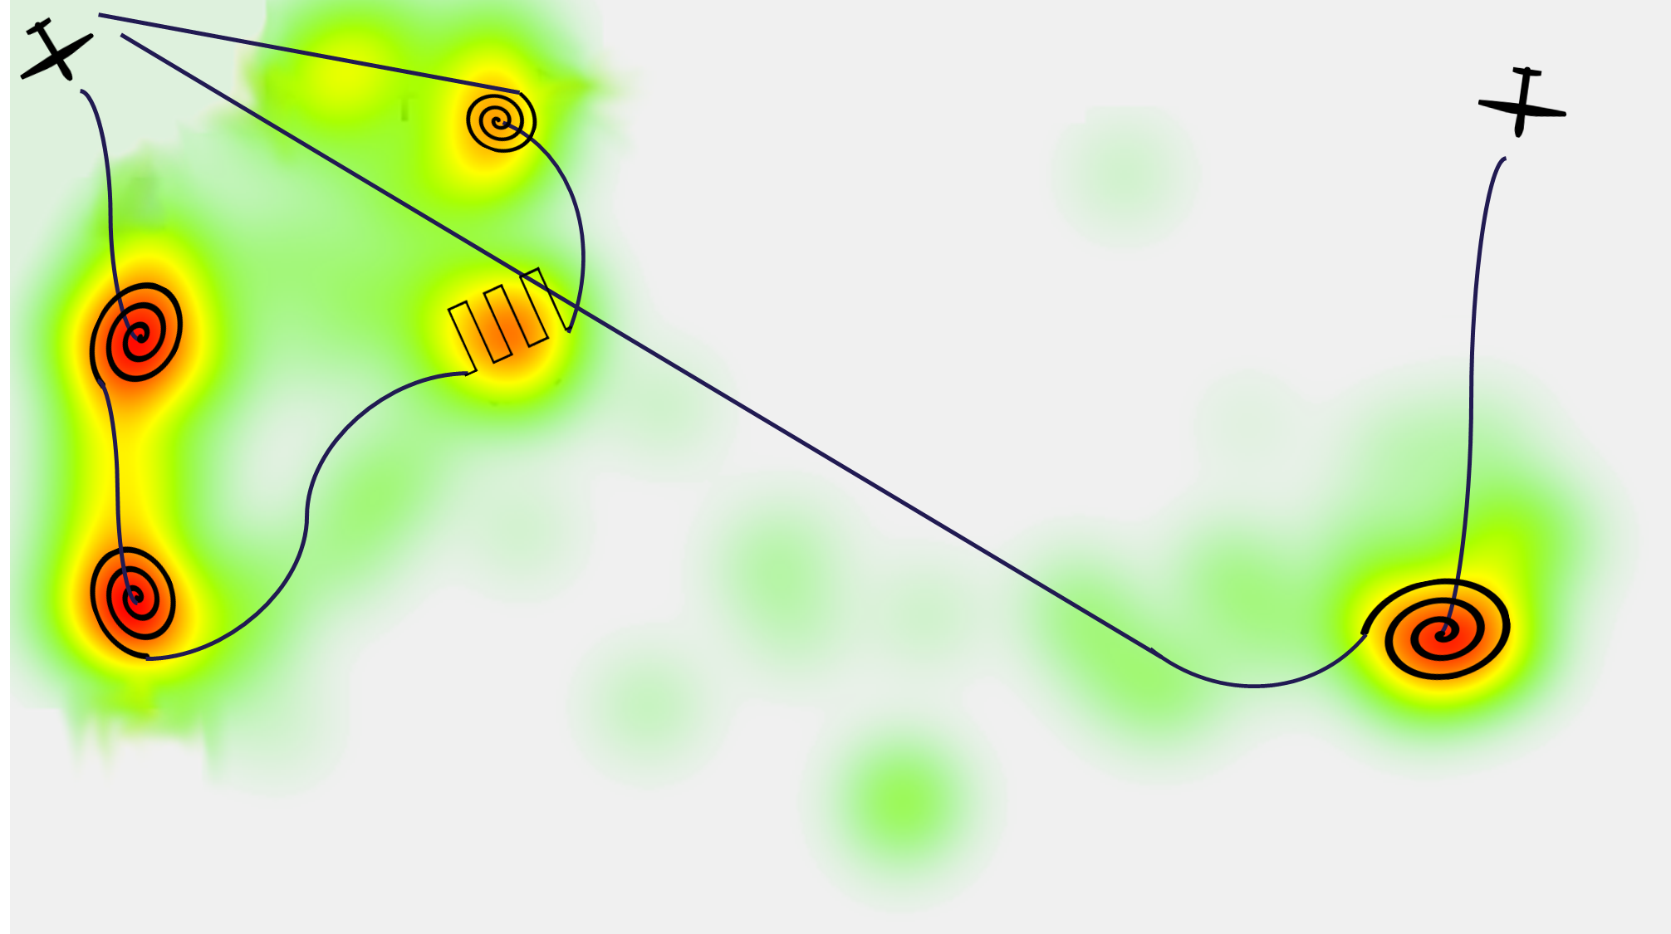
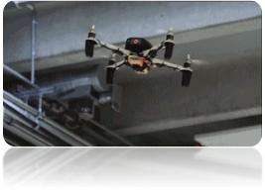
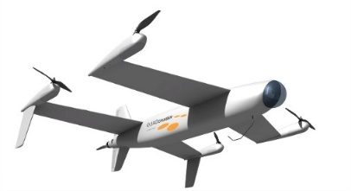
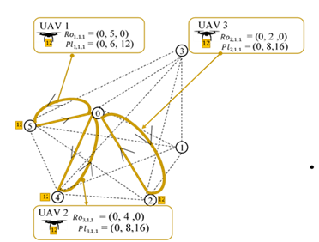
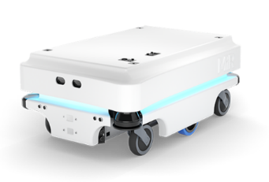
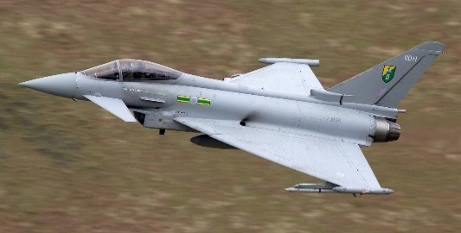
Operations Research
RESEARCH FOCUS
Planning & Scheduling of Automated Autonomous Systems
Large NP-hard Problems
Modeling and Evaluating Stochastic Systems
PRIMARILY APPLIED FOR:
Automated Manufacturing Systems
Supply Chains
Mission Planning for:
  Search & Rescue
  Emergency Response
  Intelligence, Surveillance, and Reconnaissance
  Mapping

Slide 18
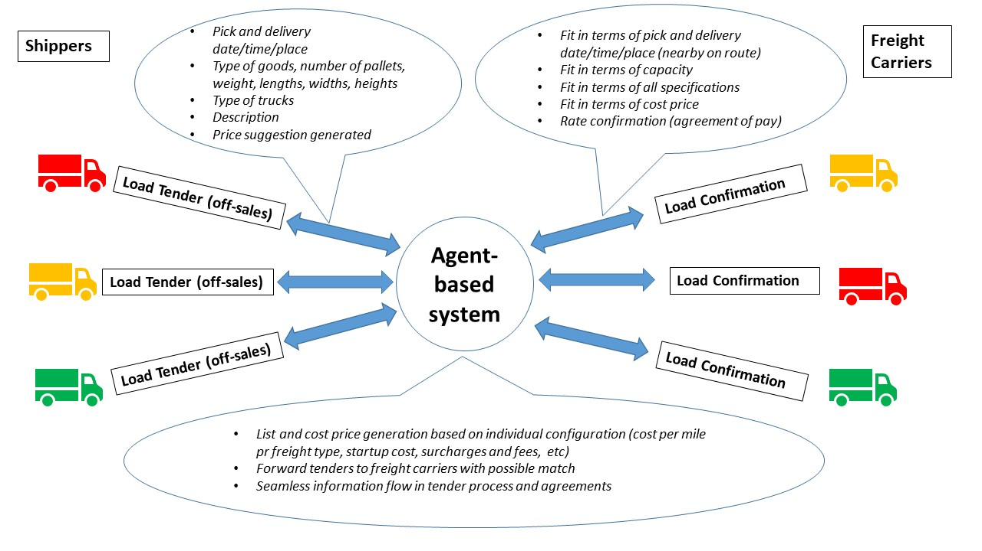

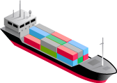

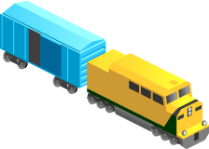




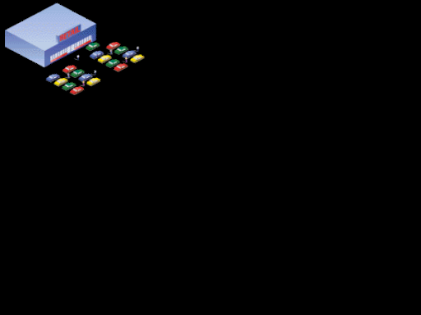
Centre for Logistics
RESEARCH FOCUS
Operations and supply chain planning, specifically
through demand and supply coordination, data and
information sharing, and information technology-
enabled processes
High domain knowledge on how to adapt and implement planning frameworks & technology from the manufacturing sector into the maritime, healthcare & retail sectors to improve effectiveness and efficiency
Use and integration of systems, mainly
  Planning and Control (ERP, APS, VMI)
  Transport and Warehouse Management Systems
  Business Intelligence & Analytics
Multimodal distribution
Supply Base
Material
Suppliers
Component
Supplier
Manufacturer
Distributors
Contract
Manufacturer
Supply
Channels
Customers
Retailers
Distribution
Channels
Consumer
Business

Slide 19

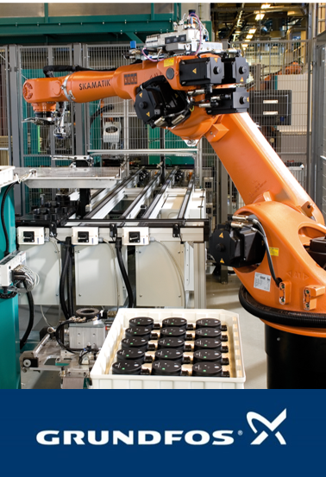

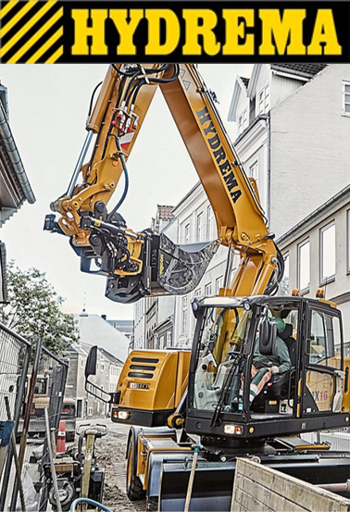
Mass Customization
Research focus
Mass customization and product configuration from both product and manufacturing view
Reconfigurable manufacturing systems and changeable manufacturing systems
Product platforms and manufacturing platforms – co-development and co-configuration
Measurement and performance metrics in mass customization and reconfigurable manufacturing system
Application area
Industrial manufacturing systems
Durable goods and process industry
Enterprises and SMV

